Slide 1
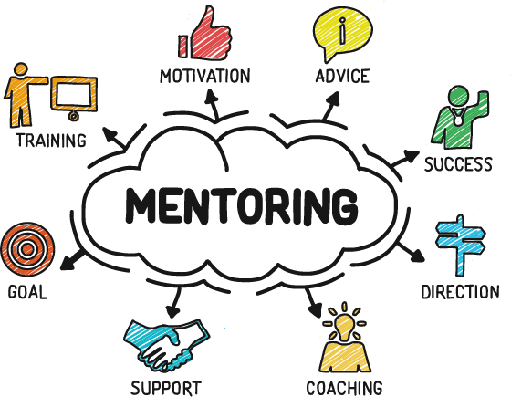

Session 3:
Engaging in Empathic Conversations

Slide 2
Learning Objectives:
Understand the importance of giving vulnerable conversations with mentees time, attention, and handling these conversations with empathy.
Become aware of the personal barriers that prevent you from engaging in these conversations.
Explore structures or prompts than can increase the likelihood of these important conversations occurring within a mentoring relationship.
Learn a set of practical techniques and considerations from the literature that, when put into practice, are likely to improve and enhance mentoring relationships with mentees different from yourself.

Slide 3
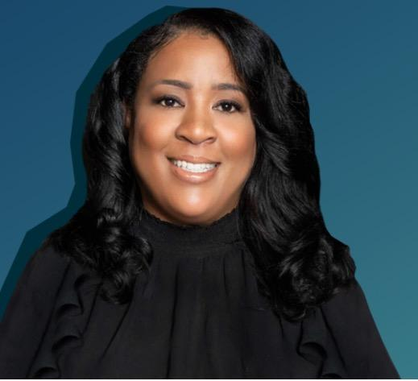
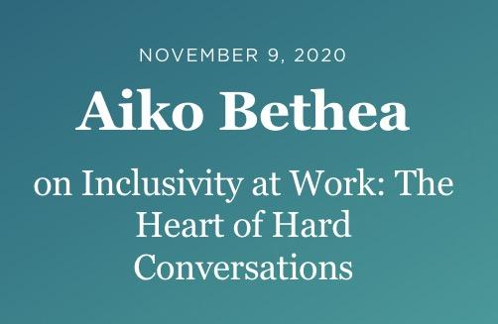
Aiko Bethea: The Heart of Hard Conversations
Brené Brown “Dare to Lead” Podcast

Slide 4
Brené and Aiko Role Play Scenario:
A black employee talks with a white supervisor about a presentation that the employee gave that made her feel invisible.
Off-ramps: conversational techniques used to brush off/avoid/”tap out of” deeper, potentially uncomfortable conversations
Examples of Minimizing/Disbelief Off-Ramps:
“Yeah, sometimes we feel that way when we give talks, so I’ll see you at noon at the next meeting…” “Well, it sounds like you might be a little sensitive…or you wanted a lot of credit, but this is a team effort…” “I’m sure you did a great job…”
Example of Savior Off-Ramp:
“That’s bs, I am going to call them into my office right now…”

Slide 5
Breakout (15 minutes)
Reflect on past vulnerable conversations you may have had as a mentor or mentee.
Ask each other:
Was the conversation handled with attention and empathy?
What were the longer-term impacts on the relationship, if any?
How did each party’s identities contribute to the conversation?

Slide 6
5-min Break

Slide 7
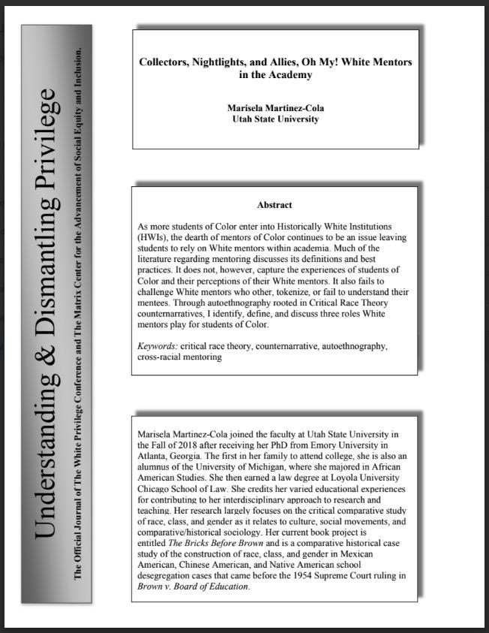
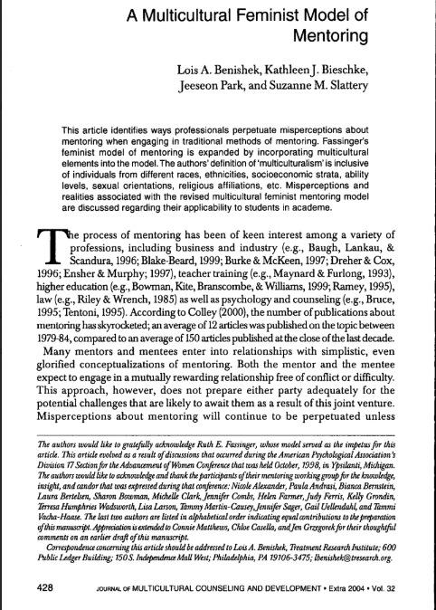
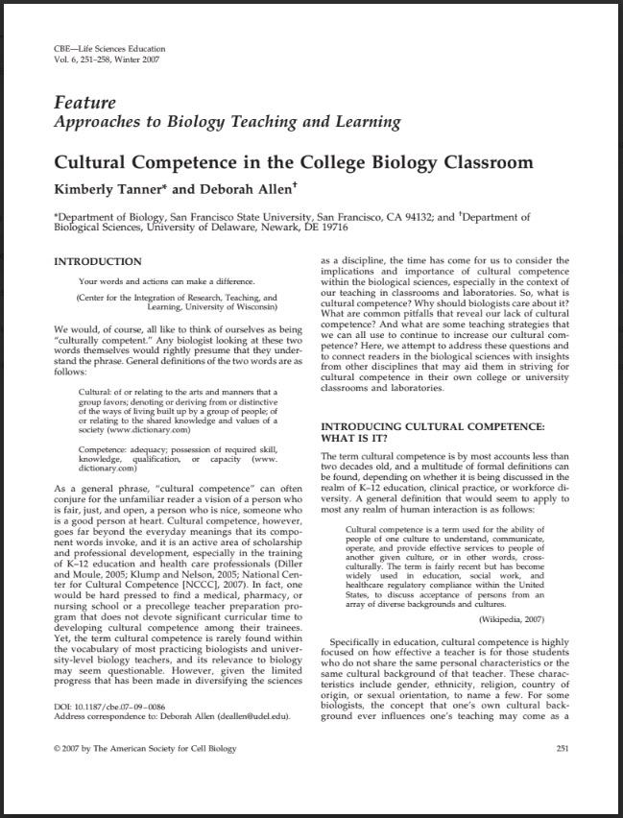
Paper #1
Paper #2
Paper #3
Martinez-Cola (2020)
[16 pages]
Benishek et al. (2004)
[14 pages]
Tanner & Allen (2007)
[7 pages]

Slide 8
Toolkit Prompts:
What are 2-3 key takeaways your group has after reading the article you chose?
What are 3-5 practical suggestions from the article you read that could be used to improve a mentoring relationship with a mentee different from yourself?

Slide 9
Group #1
How do students of Color perceive their White faculty mentors? (Autoethnography)
Collectors: “Collectors are the ones that will ask you to be in photographs or public relations materials on behalf of the university. They also often limit their interactions with students of Color to “diversity” events” (p. 30). Often fill the role of “sponsors” “…use… influence with senior executives to advocate for their mentee” (p. 31).
Nightlights: “Nightlights…are White mentors who understand the challenges inherent at HWIs and can help students of Color navigate the unknown and unforeseeable curves and twists of the academy. They, figuratively, provide light in the dark, unfamiliar places within academia” (p.32). List of 4 ways Nightlights use social capital to help students of Color (p. 33).
Allies: “Allies are by far the most aware of the experiences of students of Color…allies have “done the work” it takes to develop an appreciation and admiration for the experiences of students of Color, and this work informs their mentoring relationships” (p.36).
Martinez-Cola (2020)

Slide 10
How is a Multicultural Feminist Model (MFM) of Mentoring different from traditional mentoring and how can it be used to improve mentoring relationships with mentees different from yourself?
“MFM [is] an interactive process in which differences are a) clearly identified, b) explored when appropriate…in order to determine their relevance to the relationship and each individual’s professional development, and c) ultimately result in a relational exchange that is respectful of differences” (p. 434).
“...[MFM is] built on the sharing of power, mutuality, equality and respect….The mentor’s focus is not on the mentor’s own needs, but on the needs of the mentee” (p. 434).
TABLE 1: Characteristics of MFM Model/Benefits to Mentor/Benefits to Mentee (p. 435-436).
Categories:
Rethinking of Power
Valuing Collaboration
Integration of Dichotomies
Incorporation of Political Analysis
Group #2
Benishek et al. (2004)

Slide 11
What is Cultural Competence, why should biologists care about it, and how can college biology teachers develop cultural competence?
“Cultural competence is a term used for the ability of people of one culture to understand, communicate, operate, and provide effective services to people of another given culture….Specifically in education, cultural competence is highly focused on how effective a teacher is for those students who do not share the same personal characteristics or the same cultural background of that teacher” (p. 251).
TABLE 1: Common characteristics of culturally responsive and competent educators (p. 252).
Developing Cultural Competence as a College Biology Teacher (p. 254-256):
Monitoring and changing ordinary language in the classroom
Becoming aware of patterns of interaction with students
Integrating cultural relevance and diverse role models into curricula
Confronting and revising differing expectations and stereotypes of students
Group #3
Tanner & Allen (2007)

Slide 12
